Slide 1
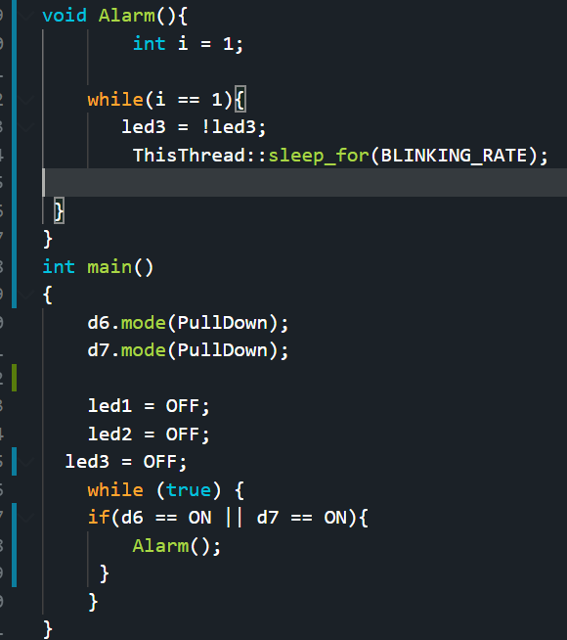
Embedded Systems Lab Worksheet
Student Name: Zeyad Karima
ID Number: 23077460
Lab. Number: 2
Date:
Lab Title:
Outline of Approach (Description of Tasks)
Itemize all key steps you took to build the required embedded system in a clear, logical and organised format.
1.Alarm activated when gas or temp detected using buttons.
2.Alarm does not stop.
3.Emergency alarm if both are turned on
4.
.
.
.
Reflection (Not more than 200 words)
I made a code for an alarm system and deactivation system for the alarm, it was a good start to the sensors we will be using later on, it made me feel confident in being able to advance my code further.
It was good to create the alarm and emergency function it made me understand how important and useful functions are when it comes to a code especially when the code becomes bigger, the ending of the 60 second timer was very hard as making a delay for 60 seconds stopped the code completely not allowing the blinking to start.
The situation was a good code and allowed me to start connecting devices to the board and learning about the inputs.
Ive learned how to connect buttons and send inputs to the code while also sending the data to the board for the LED, I also learned how important the functions are.
My plan is to continue using functions properly to organise and align my code properly.
Results for Part:1
(Input only lab results, Git-hub code link, Flow chart, calculations or picture evidence of simulation/circuits/figures obtained).
All figures should be captioned with relevant title and a brief description to present the essential details).
Simple alarm function if the buttons for gas or temp is clicked the led 1 will blink continuously.
Results for Part:
Git hub with video evidence: https://github.com/ZeyadK05/Lab-2
References
Reference guide here

Slide 2
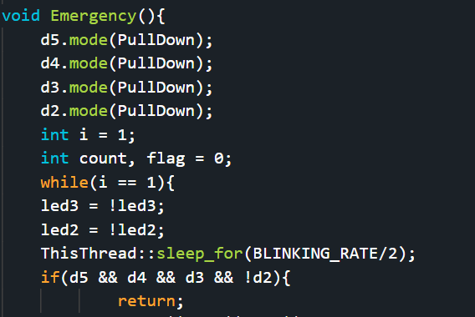
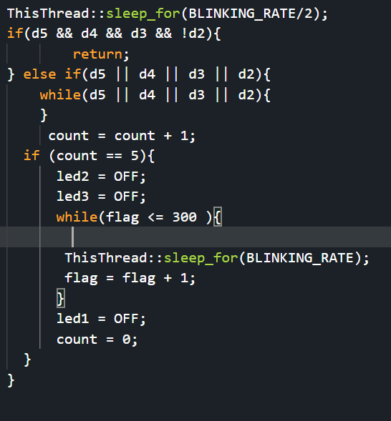
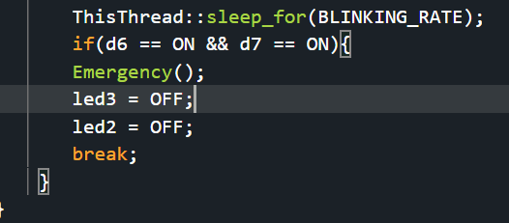
Results for Part:2
(Input only lab results, Git-hub code link, Flow chart, calculations or picture evidence of simulation/circuits/figures obtained).
All figures should be captioned with relevant title and a brief description to present the essential details).
Without changing the flag i the code will never stop the alarm no matter what alarm is turned on.
Results for Part:3
(Input only lab results, Git-hub code link, Flow chart, calculations or picture evidence of simulation/circuits/figures obtained).
All figures should be captioned with relevant title and a brief description to present the essential details).
Added emergency function which turns on when both sensors are activated at the same time and is only turned off using a code.
Results for Part:4
(Input only lab results, Git-hub code link, Flow chart, calculations or picture evidence of simulation/circuits/figures obtained).
All figures should be captioned with relevant title and a brief description to present the essential details).
Added counter 5 times if the correct code is not entered the made the blinking rate with the loop of 300 times to make it 60 seconds with a loop.

Slide 3
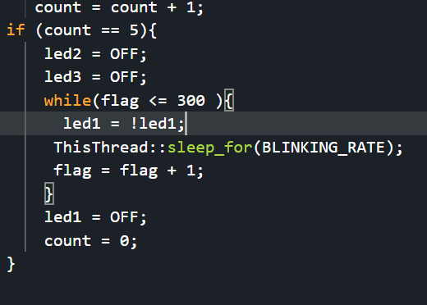
Results for Part:5
(Input only lab results, Git-hub code link, Flow chart, calculations or picture evidence of simulation/circuits/figures obtained).
All figures should be captioned with relevant title and a brief description to present the essential details).
Added LED in the loop of 60 seconds allowing it to flash for 60 seconds until the code can be entered again.
.
Results for Part:
(Input only lab results, Git-hub code link, Flow chart, calculations or picture evidence of simulation/circuits/figures obtained).
All figures should be captioned with relevant title and a brief description to present the essential details).
Results for Part:
(Input only lab results, Git-hub code link, Flow chart, calculations or picture evidence of simulation/circuits/figures obtained).
All figures should be captioned with relevant title and a brief description to present the essential details).

